Slide 1


Samuel Eleshinnla
179441
  Development of a Power BI-based Decision Support System for Inventory Tracking and Replenishment in Small Retail Stores
University of Ibadan | 2026
Supervisor: Dr. Oladunni Okunade

Slide 2
  PRESENTATION OUTLINE
01
Introduction
02
Problem Statement
03
Aim & Objectives
04
Literature Review
05
Gaps
06
Methodology
07
Tables & Models
08
Expected Results
09
Actual Results
10
Conclusion
11
References

Slide 3


Slide 4


Slide 5
  INTRODUCTION
Inventory management is the systematic process of ordering, storing, tracking, and controlling a company’s raw materials, work-in-progress, and finished goods
Over 80% of informal employment in developing nations stems from SMEs
Monthly stockouts affect 60% of small retail businesses in Sub-Saharan Africa
Most small retailers use spreadsheets or manual ledgers with no automated alerts: 63.3% of SMEs in Malawi still rely on paper-based systems (Chimbuto, 2026)
Microsoft Power BI is used by over 375,000 organizations and more than 30 million monthly active users

Slide 6


  PROBLEM STATEMENT
Frequent Stockouts
Excessive Overstocking
Reliance on paper logs drives customers directly to competitors, significantly damaging revenue and losing loyalty.
Tying up precious working capital in slow-moving goods increases carrying cost and waste. It prevents investment in other growth areas for the business.
Lack of Visibility
Internal Theft
Without centralized digital tools, managers cannot determine exactly what is on the shelf or when to reorder.
Because owners cannot track inventory counts to the unit, employees and suppliers are likely to attempt internal theft because they know it might go unnoticed.
Manual Inventory Tracking Cripples Profitability

Slide 7

  AIM & OBJECTIVES
Aim
To design and develop a Power BI-based Decision Support System that provides inventory visibility and automated reorder alerts for small retail stores.
Objectives
Design a structured data entry framework in Microsoft Excel for capturing multi-point inventory transactions.
Develop the data model and replenishment logic to automatically signal 'when to order what' based on calculated reorder points.
Design a Power BI dashboard that visualizes current stock levels, product categories, and total inventory value.
Validate the technical accuracy of dashboard alerts against historical sales and current stock.

Slide 8
  LITERATURE REVIEW
S/N | First Author's name | Study Title | Study Objective | Year of Publication | Type of Review | Scope Conclusion from the Abstract
1 | Cosmin Condea | RFID-enabled shelf replenishment with backroom monitoring in retail stores | To test an inventory control policy based on RFID data with case-level tagging | 2012 | Literature Review | RFID-based policies have the potential to improve cost efficiency and service levels. However, different sensitivities to cost factors and suboptimal read rates must be considered when choosing a policy.
3 | Kamilah Ahmad | Inventory management practices among Malaysian micro retailing enterprises | To examine the current state of inventory management practices and factors that influence their use in micro retailing enterprises | 2016 | Literature Review | Purchasing and Controlling are the most frequent inventory management activities applied by micro enterprises as opposed to Storage and Tracing. Results suggest that owner/manager's attitude and knowledge in inventory management have significant and positive influences on inventory management practices.
3 | Franklin Chandra Pragnyono Seto | Business Intelligence for Decision Support System for Replenishment Policy in Mining Industry | To integrate Microsoft Power BI with the company's ERP system to support decision making | 2023 | Literature Review | The Business Inelligence system helped inventory workers make forecasts and decisions and make decisions faster, even when they are in remote locations, far from the head office.
4 | Srikanth Yerra | Enhancing inventory management through real-time Power BI dashboards and KPI tracking | To explore how Power BI dashboards and Key Performance Indicator (KPI) tracking can revolutionize inventory management by providing real-time visibility, data-driven decision-making, and predictive analytics. | 2025 | Literature Review | The study found that inventory accuracy improved by 85%, demand forecasting accuracy increased from 75% to 92%, and storage costs were reduced by 30%. Additionally, labor efficiency improved by 20%, with organizations experiencing 35% less inventory wastage.

Slide 9
  GAPS
While the literature confirms the value of BI-driven inventory dashboards in large organizations and ERP-integrated environments, a critical gap remains: the absence of a purpose-built, low-cost Power BI Decision Support System specifically designed for small retail stores operating in resource-constrained, developing-economy settings.
What Existing Literature Covers
What This Project Addresses
Large enterprise ERP integrations (SAP, Dynamics 365)
Cloud-based platforms requiring significant IT infrastructure
Studies focused on manufacturing and logistics — not micro-retail
Solutions requiring advanced technical expertise to maintain
High-end AI/IoT implementations beyond SME financial reach
Microsoft Excel + Power BI: zero licensing cost for core functionality
Structured Excel data entry framework accessible to non-IT users
Retail-specific KPIs: stock-on-hand, reorder points, inventory value
Automated replenishment alert logic tailored to small-store lead times
Validation against real historical sales data from local small stores

Slide 10
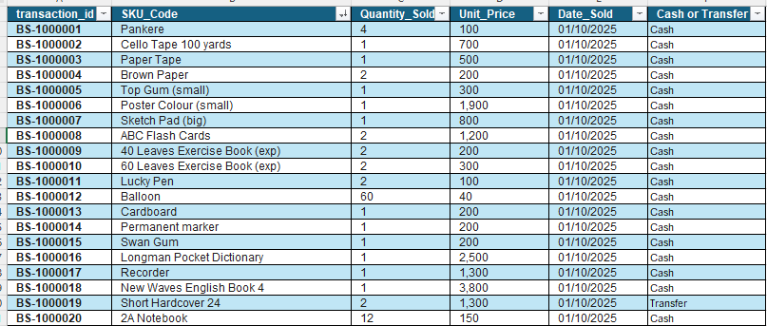
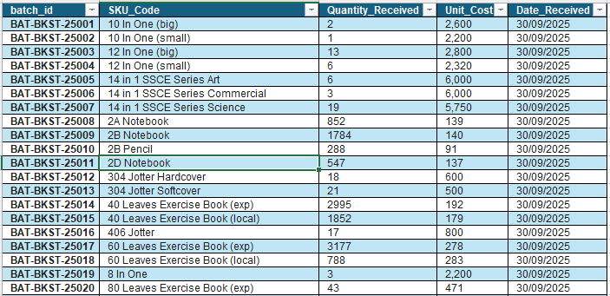
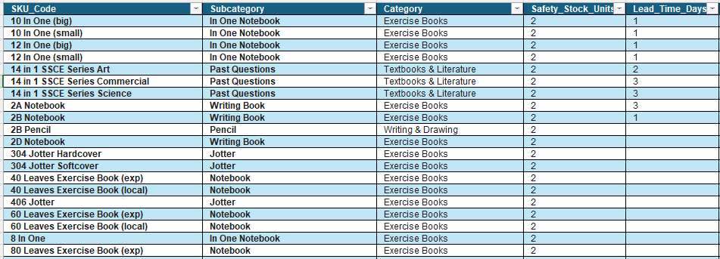
  METHODOLOGY
Sales Table
Purchases Table
Between October 2025 and September 2026
12955 Sales Transactions
Products Table
Between October 2025 and September 2026
758 Unique Items Sold

Slide 11
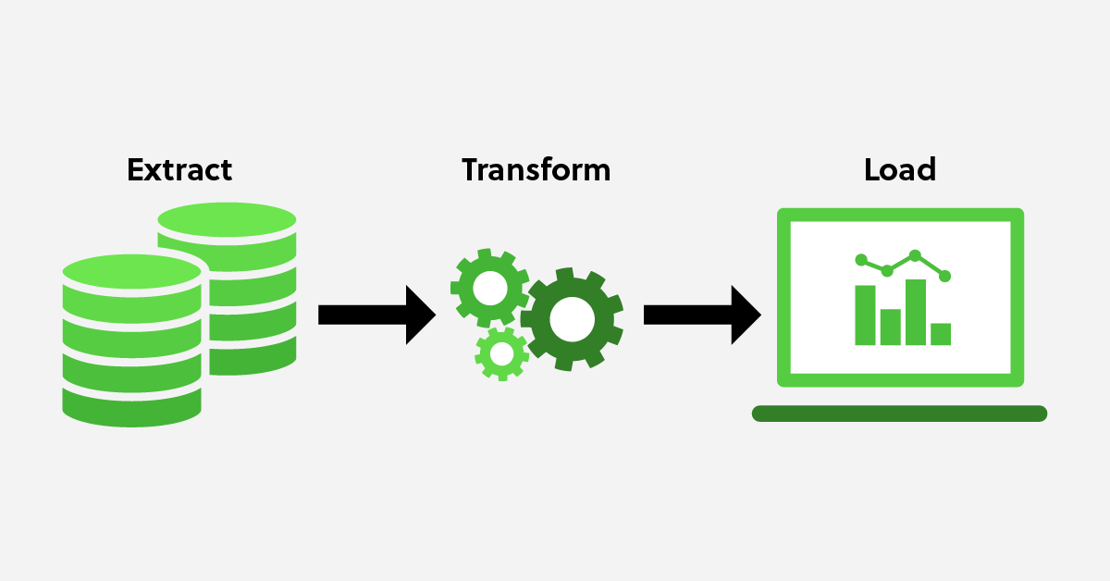
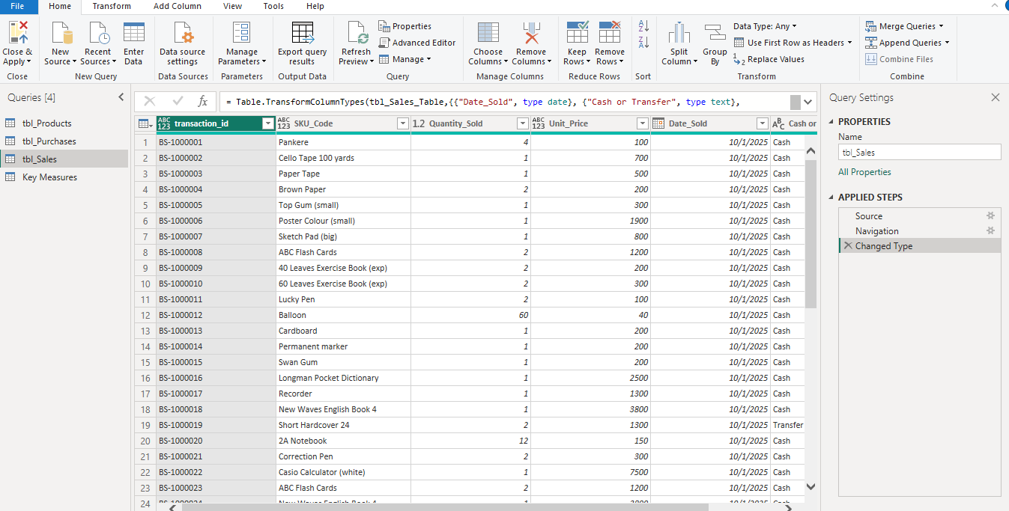
  METHODOLOGY

Slide 12
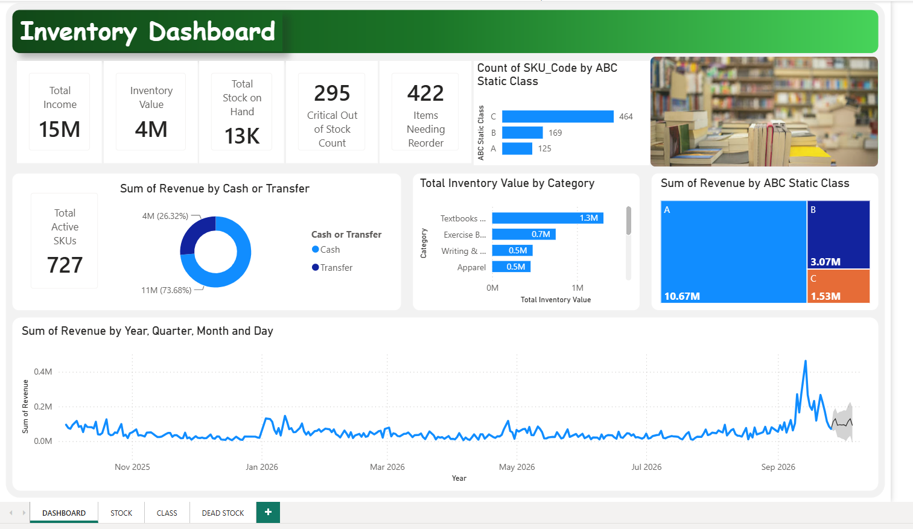
  METHODOLOGY

Slide 13

  METHODOLOGY

Slide 14
  TABLES AND MODELS
01
Products Table

Slide 15
  TABLES AND MODELS
01
Products Table
02
Purchase Table

Slide 16
  TABLES AND MODELS
01
Products Table
02
Purchase Table
03
Sales Table

Slide 17
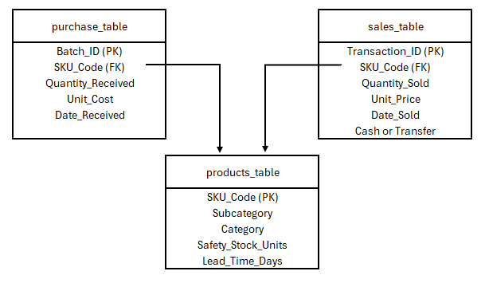
  TABLES AND MODELS
Framework

Slide 18
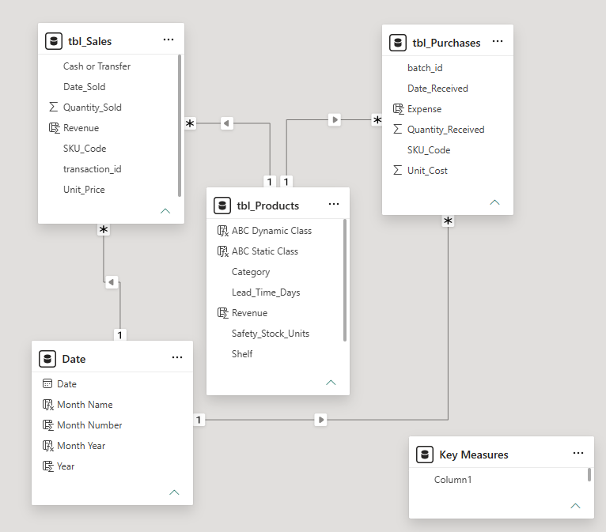
  TABLES AND MODELS
01
Products Table
02
Purchase Table
Model
03
Sales Table
Framework

Slide 19


  MATHEMATICAL MODELS
01
Demand Velocity: Average Daily Usage (ADU)
$$ADU=\frac{\sum_{t=1}^{30}{{\text{Sales}}_{t}}}{30\text{ Days}}$$
02
Replenishment Threshold: Dynamic Reorder Point (ROP)
$$ROP=\left(ADU×L\right)+SS$$
03
ABC Pareto Classification
$$Class A items=70\% of Annual Income$$
$$Class B items=20\% of Annual Income$$
$$Class A items=10\% of Annual Income$$

Slide 20
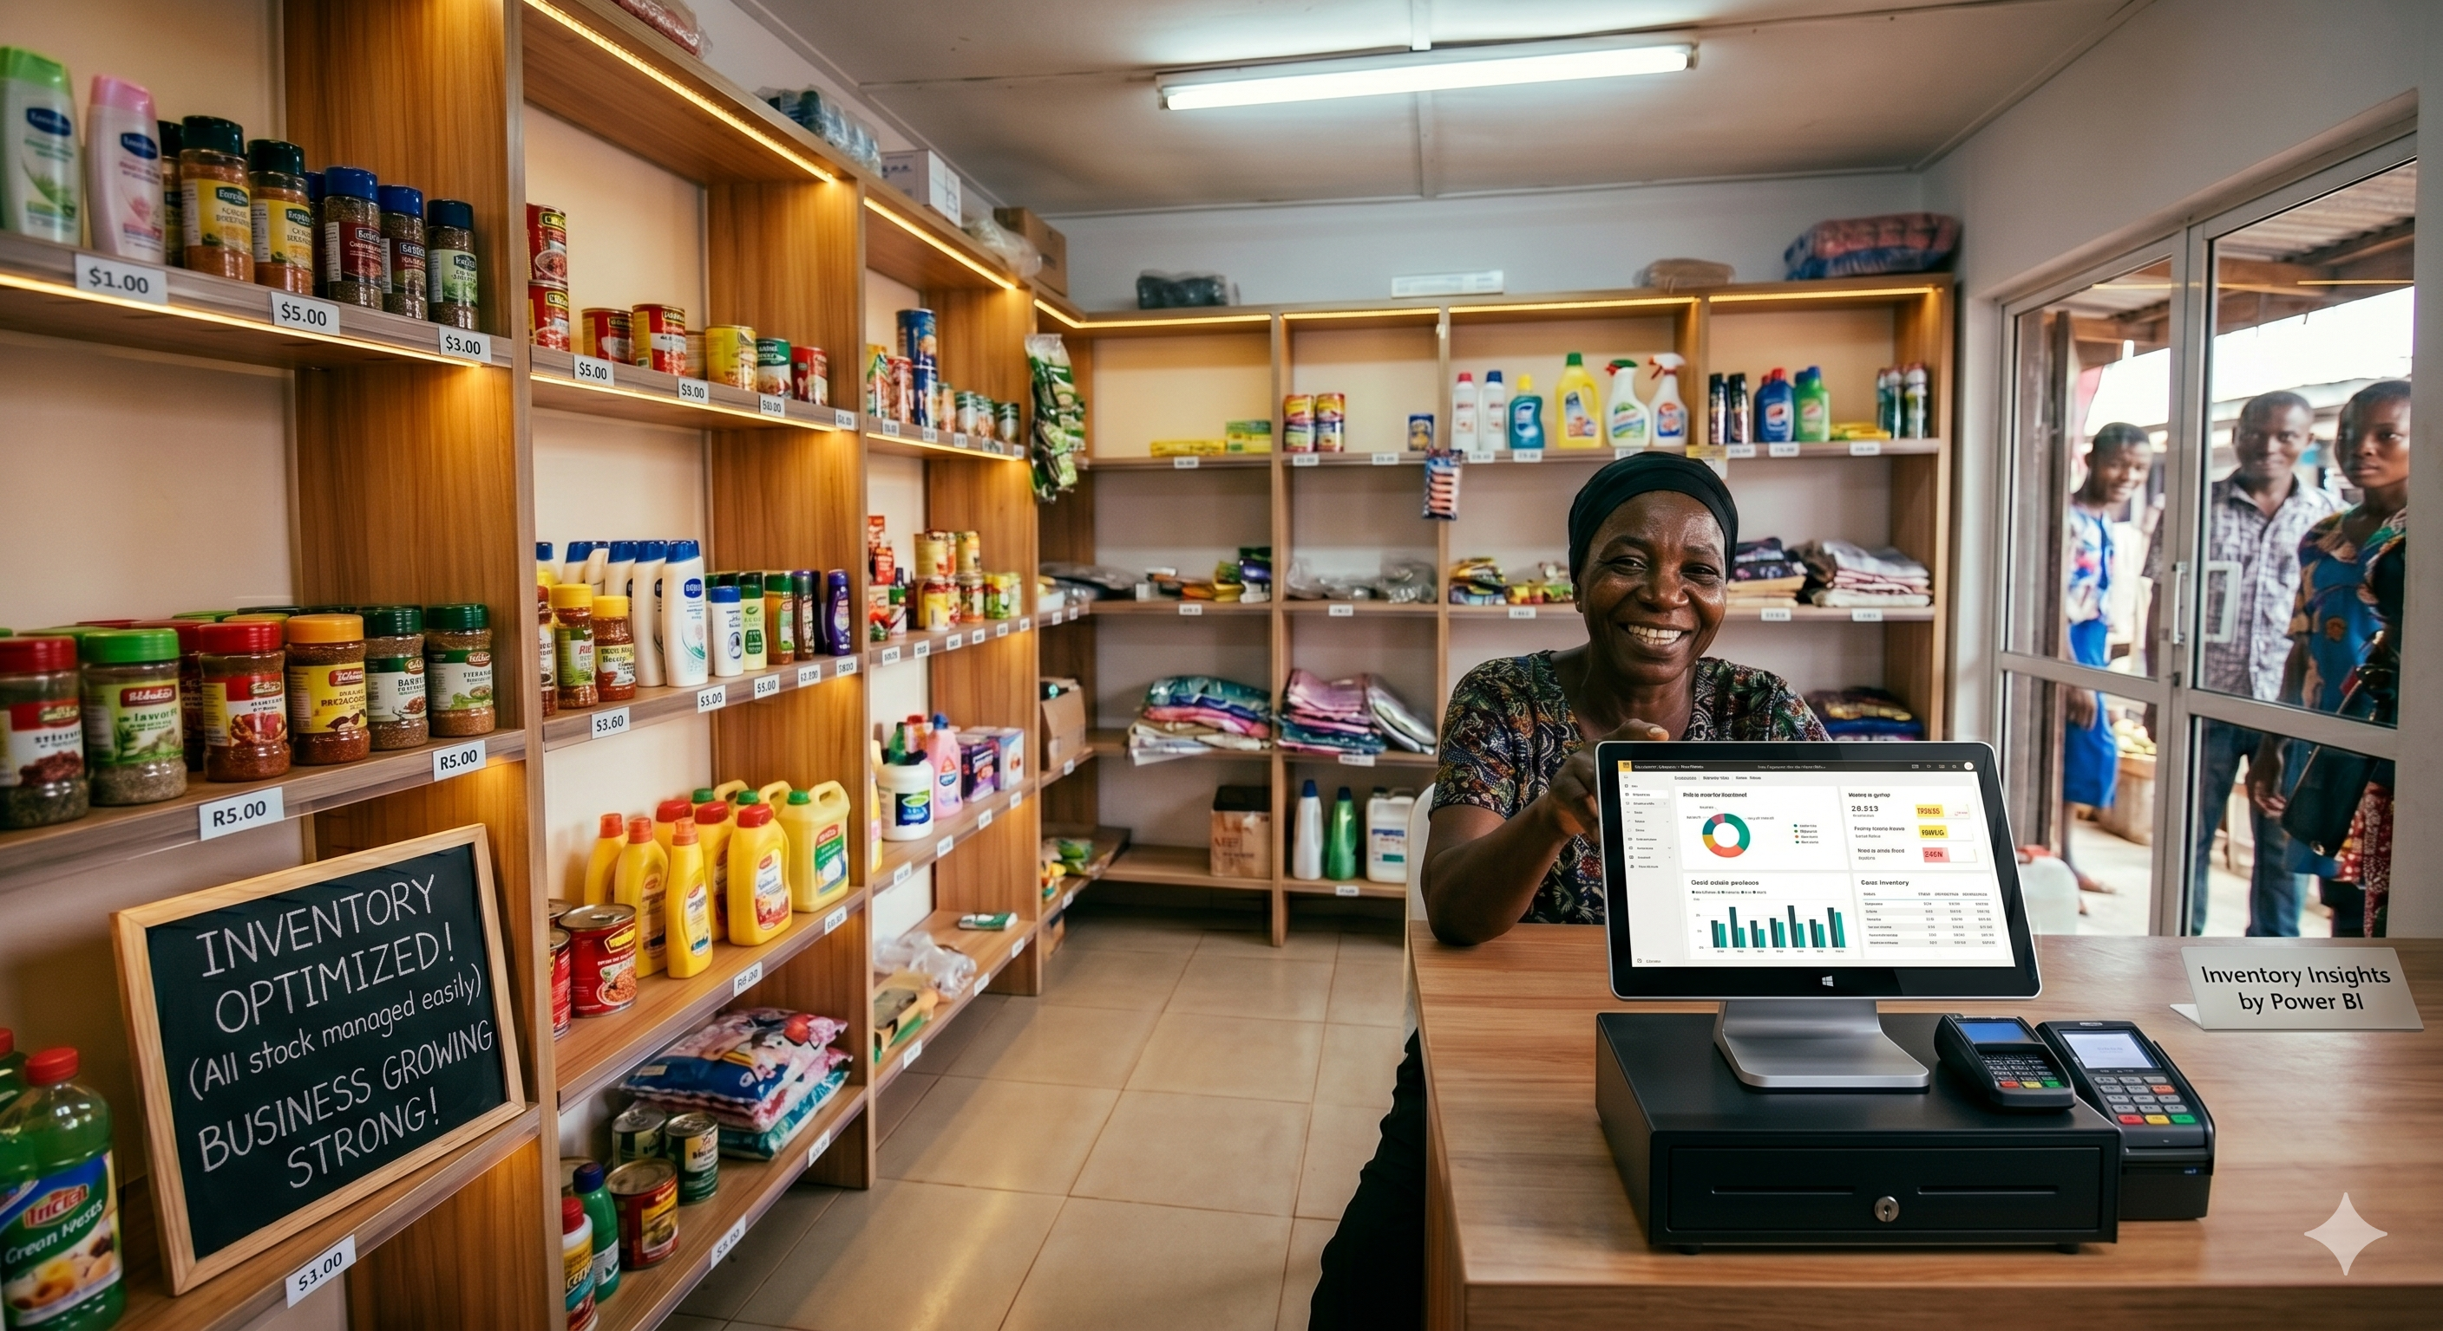
  EXPECTED RESULTS
01
Inventory Accuracy
The percentage match between what the Power BI system says is on the shelf versus what is physically on the shelf.
02
Stockout Reduction
How frequently an item is out of stock when a customer wants to buy it.
03
Ordering Processing Time
The time taken from realizing stock is low to placing the order with the supplier.
04
Cost Savings (ROI)
Reduction in total operational costs related to inventory.

Slide 21
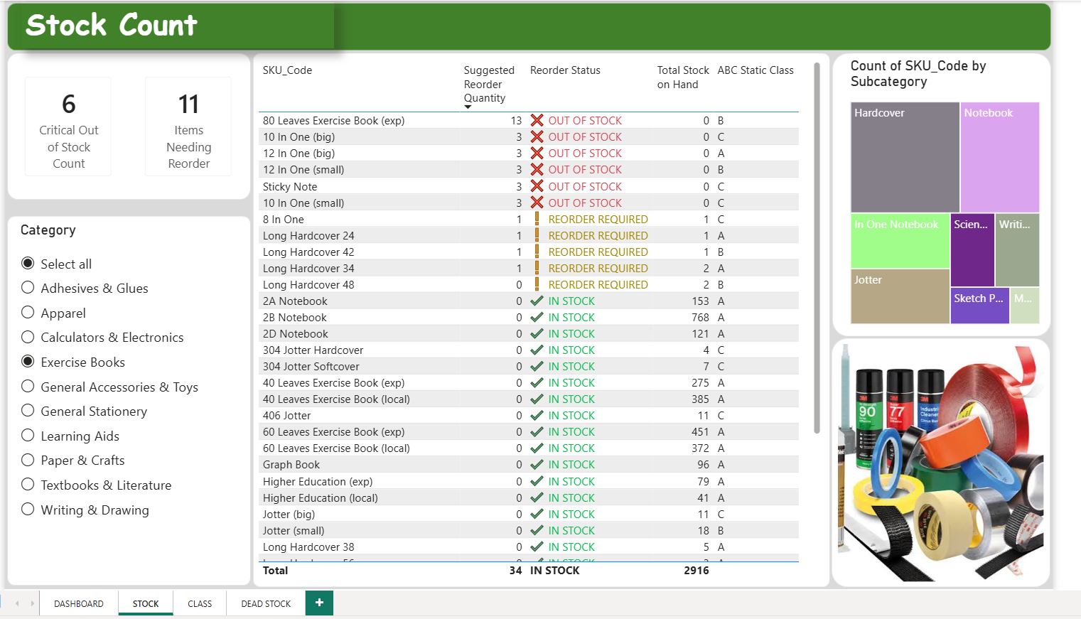
  ACTUAL RESULTS

Slide 22
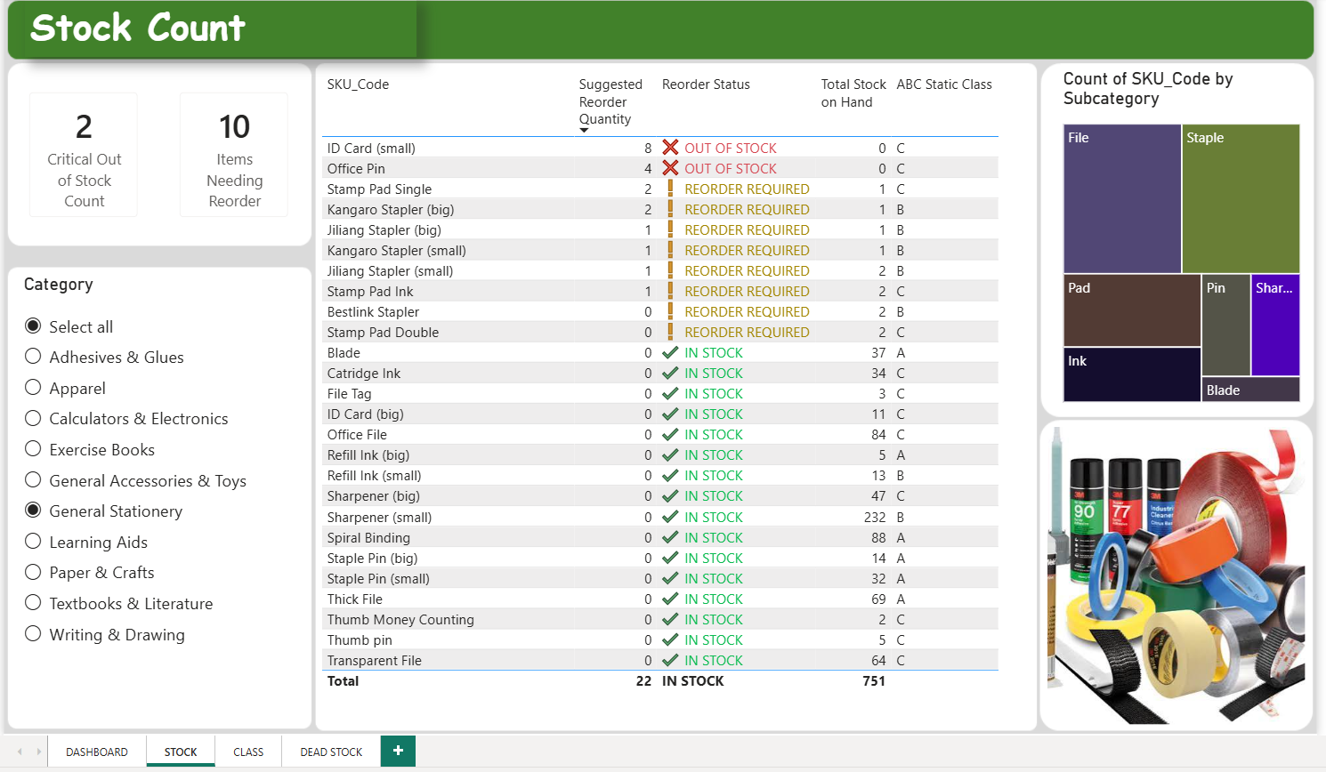
  ACTUAL RESULTS

Slide 23
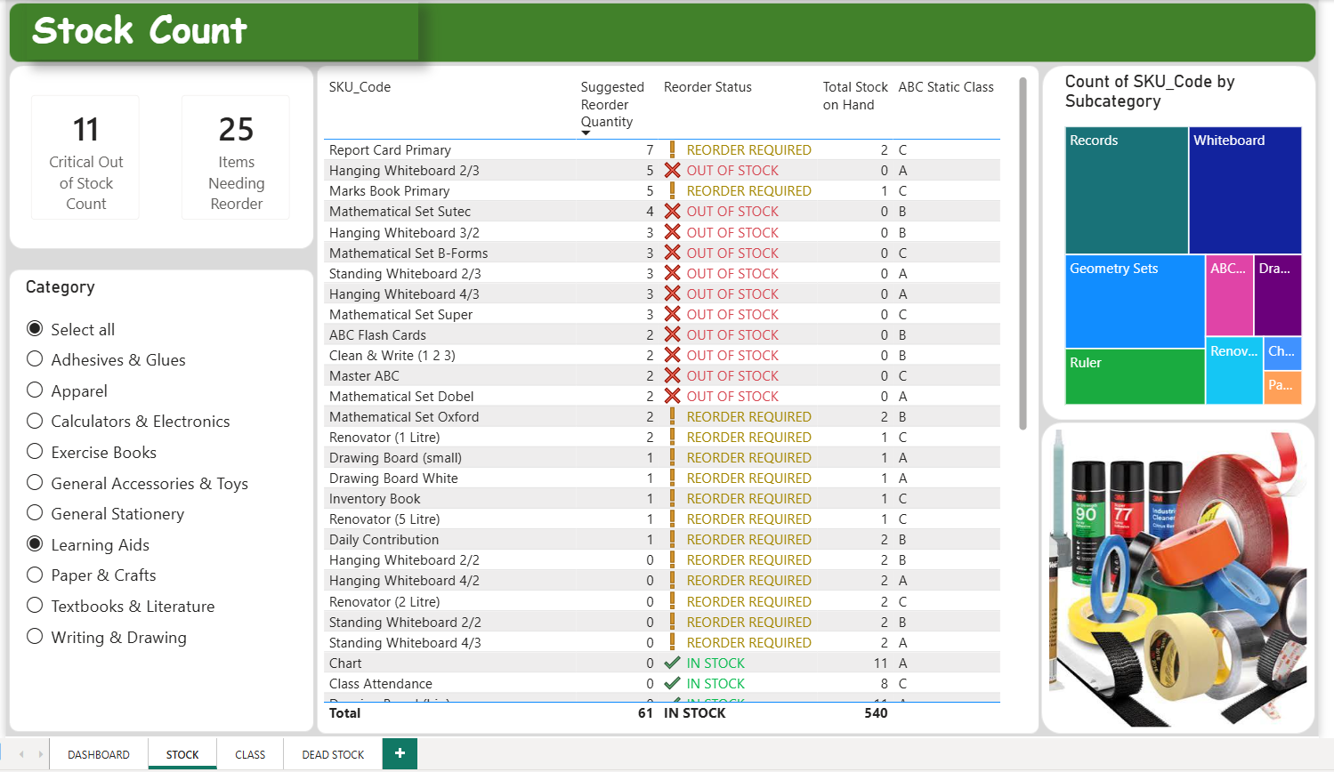
  ACTUAL RESULTS

Slide 24
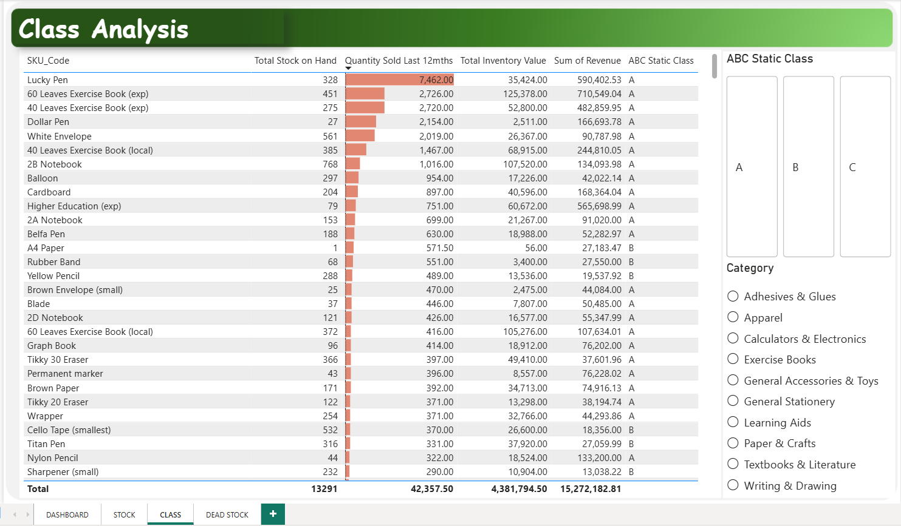
  ACTUAL RESULTS

Slide 25
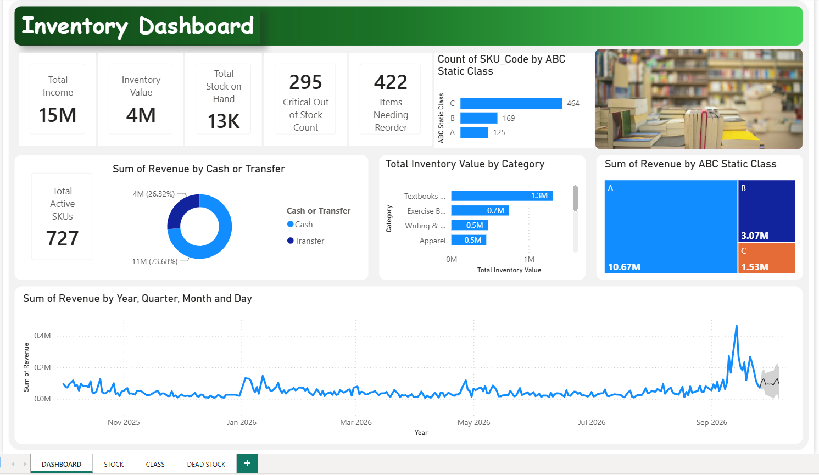
  ACTUAL RESULTS

Slide 26
  ACTUAL RESULTS
  ABC Distribution

Slide 27
  ACTUAL RESULTS
  Executive Overview

Slide 28
  ACTUAL RESULTS

Slide 29
  ACTUAL RESULTS
  Sales Trend with Forecast

Slide 30
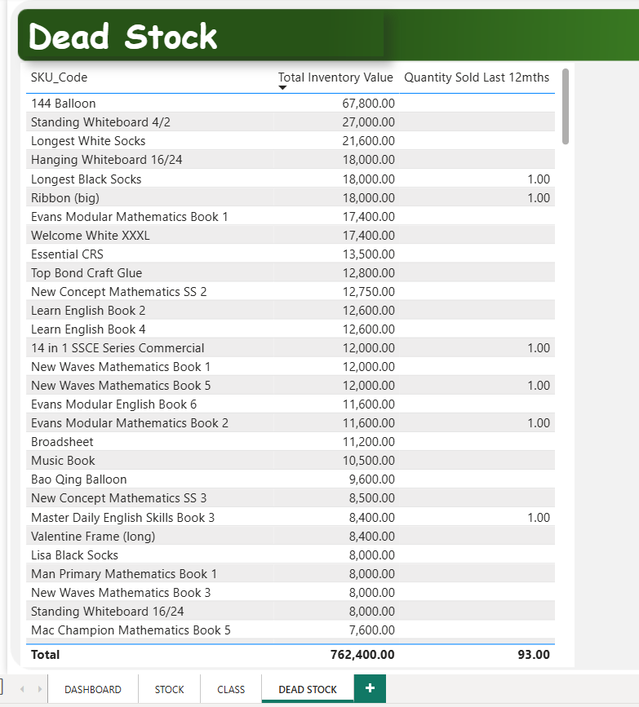
  ACTUAL RESULTS

Slide 31
  CONCLUSION: Business Value
A Quick Recap
01
Tracking hundreds of items through tens of thousands of rows in multiple books is tough
02
Advanced technologies require high CAPEX and OPEX, and high technical skills
03
My system transforms static data into automated decision-making
04
Working capital is freed up by identifying dead stock
05
It reduces administrative ordering costs and prevents stockouts without recurring software subscription fees

Slide 32
  REFERENCES
Al Maruf, A., 2025. A systematic review of ERP-integrated decision support systems for financial and operational optimization in global retails business. American Journal of Interdisciplinary Studies, 6(1), pp.236-262.
Alam, M. K., Thakur, O. A., & Islam, F. T. 2024. Inventory management systems of small and medium enterprises in Bangladesh. Rajagiri Management Journal.
Bello, Solomon & Ugheoke, Iyenagbe & Ejiako, Maryjane. 2025. Development of a Decision Support System for Inventory Management in a Pharmaceutical Retail Outlet.
Christopher Petro Chimbuto, 2026. Enhancing Inventory Optimization Strategies for SMEs: Addressing Key Challenges in Mzuzu, Malawi. International Journal of Innovative Science and Research Technology, 11(2), 3119-3124. https://doi.org/10.38124/ijisrt/26feb1194
Fang, X., & Chen, H. C. 2022. Using vendor management inventory system for goods inventory management in IoT manufacturing. Enterprise Information Systems, 16(7), 1885743. https://www.tandfonline.com/doi/abs/10.1080/17517575.2021.1885743
Munyaka, J.B. and Yadavalli, V.S.S., 2022. Inventory management concepts and implementations: a systematic review. South African Journal of Industrial Engineering, 33(2), pp.15-36.
Samaranayake, P. 2009. Business process integration, automation, and optimization in ERP: integrated approach using enhanced process models. Business Process Management Journal,15(4), 504-526. https://doi.org/10.1108/14637150910975516

Slide 33
  THANK YOU
  Questions & Discussion

